Slide 1


SQL
FINAL PROJECT
IPL AUCTION
MD ADIL MUZAFFAR
15th JUNE, 23 BATCH

Slide 2

CONTENTS
TOPICS PAGE No.
CREATING & IMPORTING
3
BATSMAN STRIKE RATE
4
BATSMAN AVERAGE
5
BATSMAN HARD-HITTER
6
BOWLER ECONOMY
7
BOWLER STRIKE RATE
8
ALLROUNDER
9
WICKET-KEEPER
10
CREATING & IMPORTING(ADDITIONAL QUESTION)
11
ADDITIONAL QUESTION - 1,2
12-13
ADDITIONAL QUESTION - 3
14
ADDITIONAL QUESTION - 4
15
ADDITIONAL QUESTION - 5
16
ADDITIONAL QUESTION - 6
17
ADDITIONAL QUESTION - 7
18
ADDITIONAL QUESTION - 8
19-20
REALLYGREATSITE.COM
ADDITIONAL QUESTION - 9
21-22
ADDITIONAL QUESTION - 10
23
2
CONCLUSION
24

Slide 3
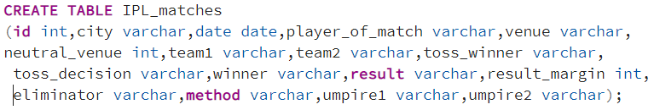
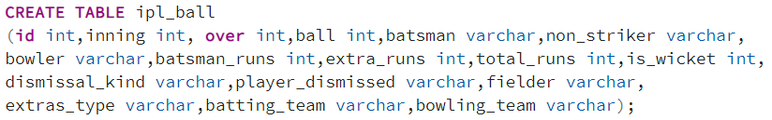
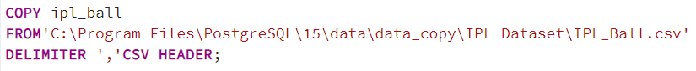
SQL FINAL PROJECT
CREATING “IPL_Matches” TABLE
CREATING “IPL_Ball” TABLE
IMPORTING DATA IN “IPL_Matches” TABLE
IMPORTING DATA IN “IPL_Ball” TABLE

Slide 4
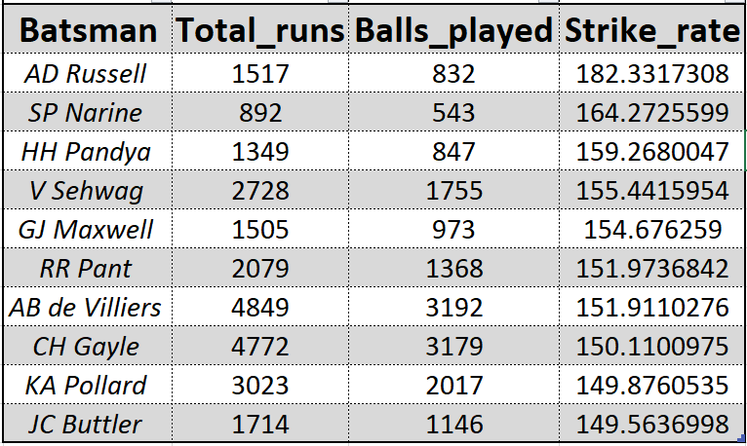
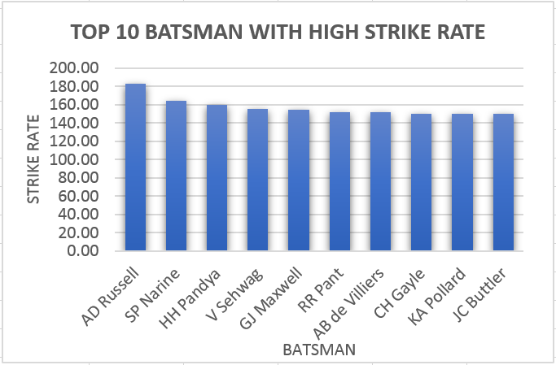
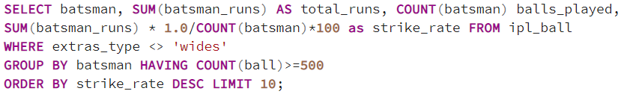
Question -1 ( Batsman Strike Rate )
Your first priority is to get 2-3 players with high S.R who have faced at least 500 balls. And to do that you have to make a list of 10 players you want to bid in the auction so that when you try to grab them in auction you should not pay the amount greater than you have in the purse for a particular player.
QUERY
REALLYGREATSITE.COM

Slide 5
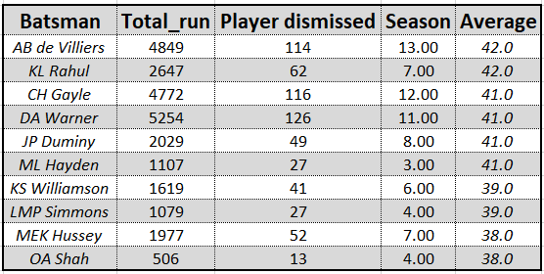

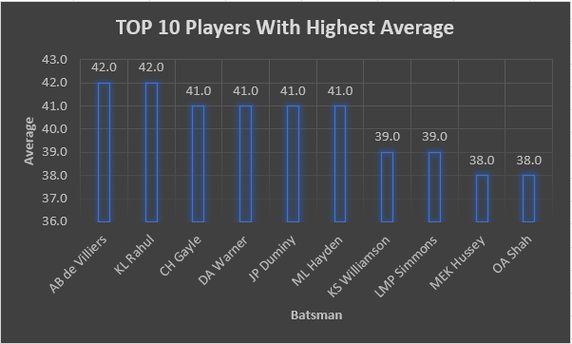
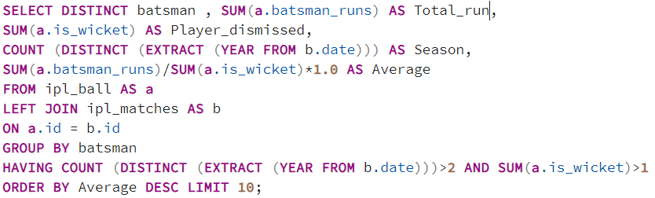
Question -2 ( Batsman Average )
Now you need to get 2-3 players with good Average who have played more than 2 IPL seasons. And to do that you have to make a list of 10 players you want to bid in the auction so that when you try to grab them in auction you should not pay the amount greater than you have in the purse for a particular player.
REALLYGREATSITE.COM

Slide 6
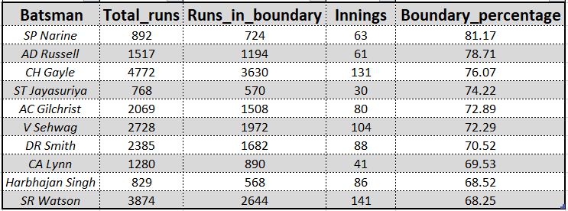

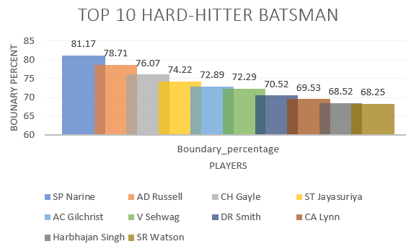
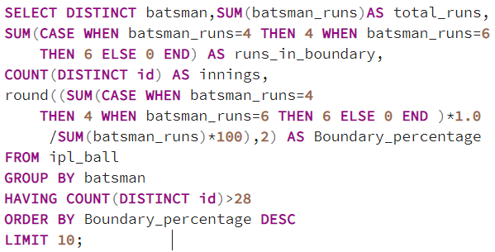
Question -3 ( HARD-HITTER )
Now you need to get 2-3 Hard-hitting players who have scored most runs in boundaries and have played more the 2 ipl season. To do that you have to make a list of 10 players you want to bid in the auction so that when you try to grab them in auction you should not pay the amount greater than you have in the purse for a particular player.
REALLYGREATSITE.COM

Slide 7
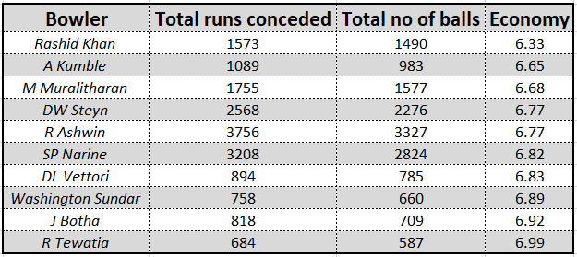

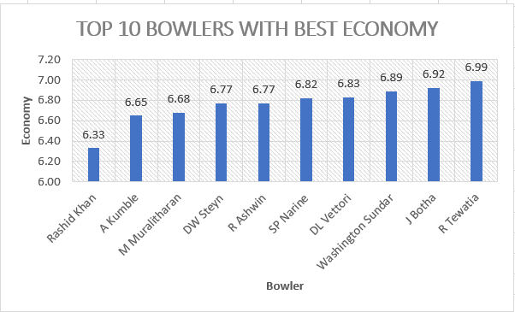
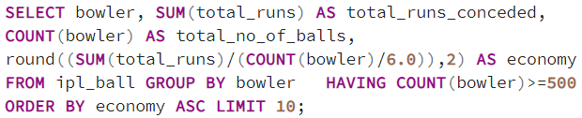
Question -4 ( Bowler Economy)
Your first priority is to get 2-3 bowlers with good economy who have bowled at least 500 balls in IPL so far. To do that you have to make a list of 10 players you want to bid in the auction so that when you try to grab them in auction you should not pay the amount greater than you have in the purse for a particular player.
REALLYGREATSITE.COM

Slide 8
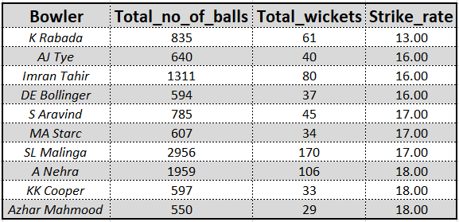
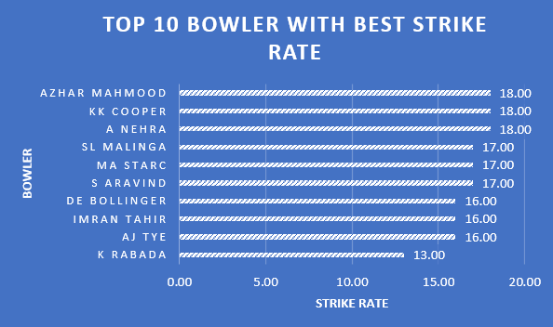
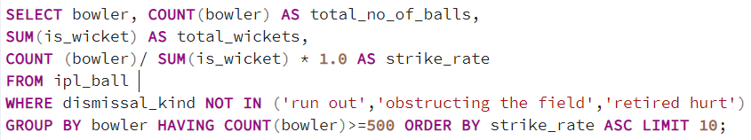
Question -5 ( BOWLER STRIKE RATE)
Now you need to get 2-3 bowlers with the best strike rate and who have bowled at least 500 balls in IPL so far. To do that you have to make a list of 10 players you want to bid in the auction so that when you try to grab them in auction you should not pay the amount greater than you have in the purse for a particular player
REALLYGREATSITE.COM

Slide 9
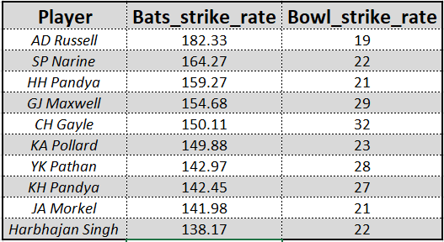

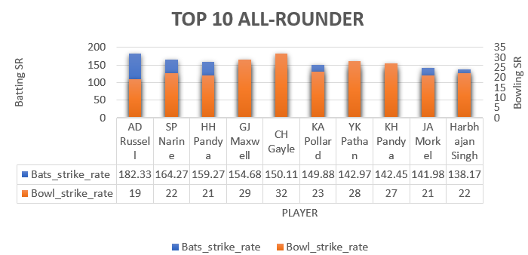
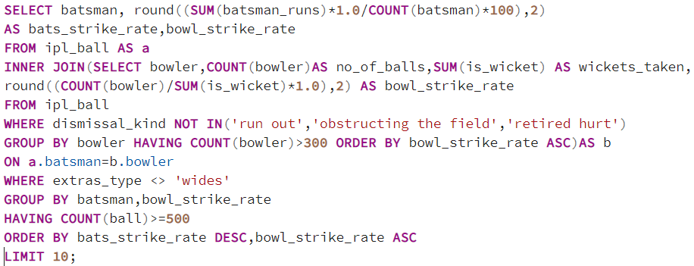
Question -6 ( ALL-ROUNDER)
Now you need to get 2-3 All rounders with the best batting as well as bowling strike rate and who have faced at least 500 balls in IPL so far and have bowled minimum 300 balls. To do that you have to make a list of 10 players you want to bid in the auction so that when you try to grab them in auction you should not pay the amount greater than you have in the purse for a particular player.
REALLYGREATSITE.COM

Slide 10
WICKET--KEEPER
Now suppose you are provided with a list of wicketkeeper names, and your task is to define the criteria for choosing the two best wicket keepers from all those names. Try to define a criteria best suited for a wicketkeeper required in a t20 team so that your team will be complete and have everything required for winning this year’s IPL.
One of the main criteria for a wicketkeeper is that he should be good at stumping and catching the ball.
He should be a prime batsman with a high strike rate.
CRITERIA
Though a wicketkeeper gets very less chance still he should be handy with bowling .
In order to select the top 2 best players who fit best as a wicketkeeper. The criteria for a wicketkeeper should be as follows:
The bowling economy should be minimal.
10

Slide 11
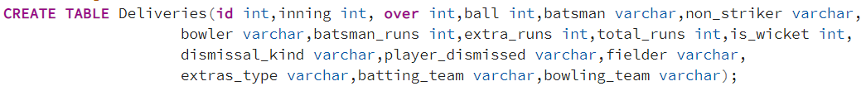
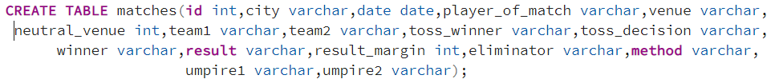
ADDITIONAL QUESTIONS
CREATING “Deliveries” TABLE Using IPL_BALL DATA
CREATING “Matches” TABLE USING IPL_MATHES DATA
IMPORTING DATA IN “Deliveries” TABLE
IMPORTING DATA IN “Matches” TABLE
REALLYGREATSITE.COM

Slide 12

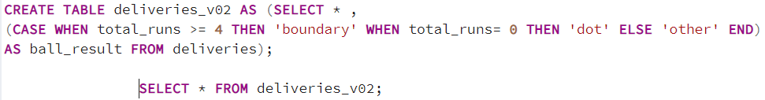
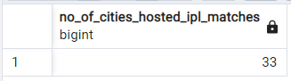
ADDITIONAL QUESTION-1
ADDITIONAL QUESTION-2
Get the count of cities that have hosted an IPL match
Create table deliveries_v02 with all the columns of the table ‘deliveries’ and an additional column ball result containing values boundary, dot or other depending on the total run (boundary for >= 4, dot for 0 and other for any other number)
QUERY
REALLYGREATSITE.COM

Slide 13

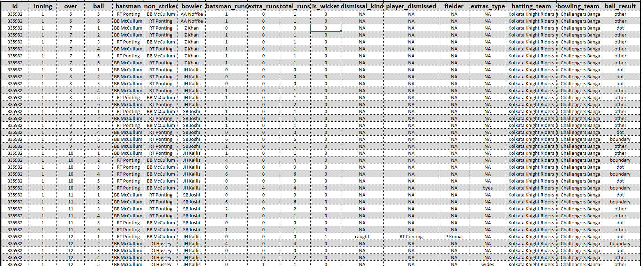
ADDITIONAL QUESTION-2 OUTPUT
REALLYGREATSITE.COM

Slide 14
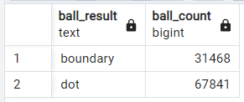

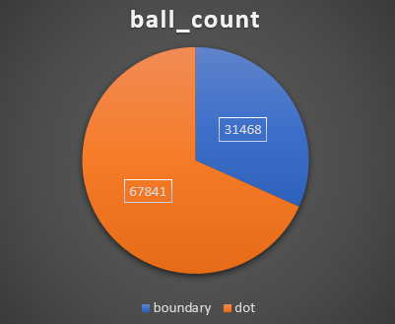
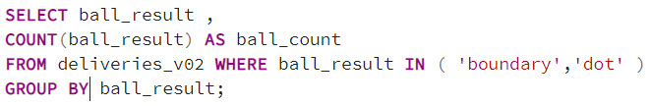
ADDITIONAL QUESTION-3
Write a query to fetch the total number of boundaries and dot balls from the deliveries_v02 table.
REALLYGREATSITE.COM

Slide 15

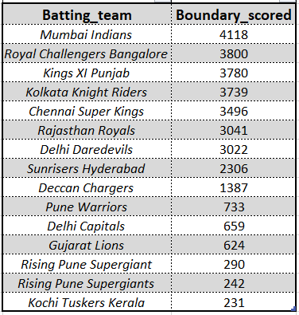

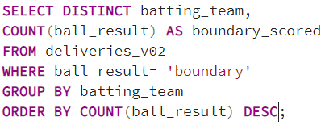
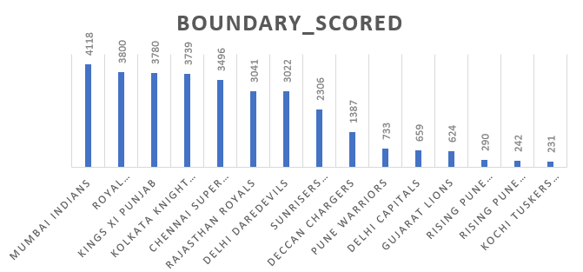
ADDITIONAL QUESTION-4
Write a query to fetch the total number of boundaries scored by each team from the deliveries_v02 table and order it in descending order of the number of boundaries scored.
REALLYGREATSITE.COM

Slide 16
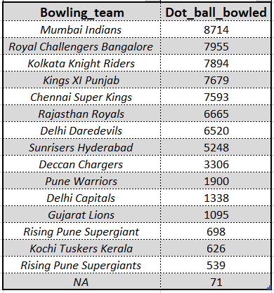
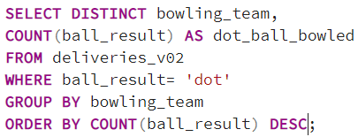
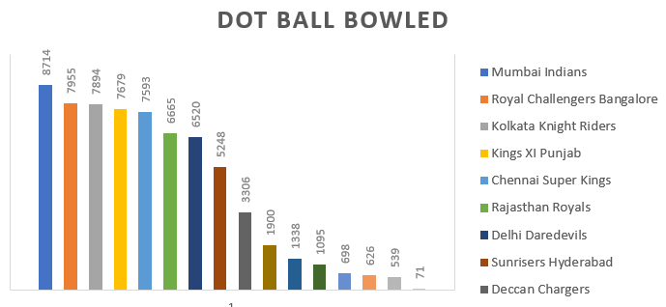
ADDITIONAL QUESTION-5
Write a query to fetch the total number of dot balls bowled by each team and order it in descending order of the total number of dot balls bowled.
REALLYGREATSITE.COM

Slide 17
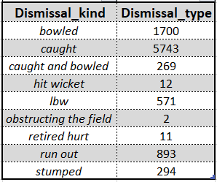
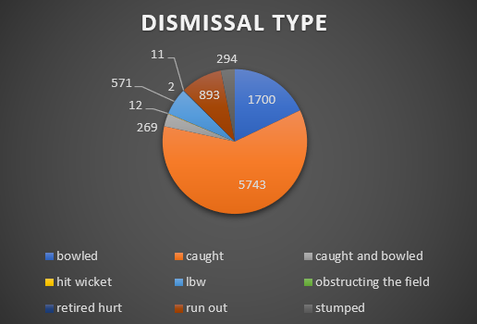
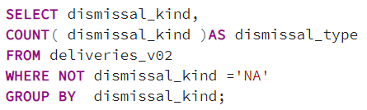
ADDITIONAL QUESTION-6
Write a query to fetch the total number of dismissals by dismissal kinds where dismissal kind is not NA
REALLYGREATSITE.COM

Slide 18
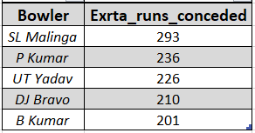
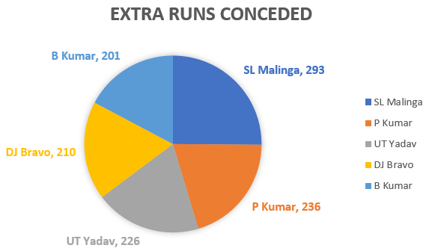
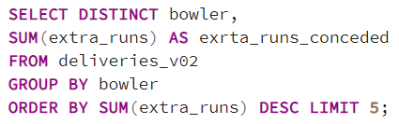
ADDITIONAL QUESTION-7
Write a query to get the top 5 bowlers who conceded maximum extra runs from the deliveries table
REALLYGREATSITE.COM

Slide 19
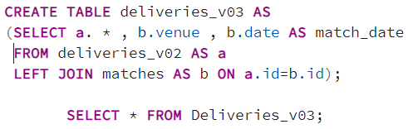
ADDITIONAL QUESTION-8
QUERY
Write a query to create a table named deliveries_v03 with all the columns of deliveries_v02 table and two additional column (named venue and match_ date) of venue and date from table matches
REALLYGREATSITE.COM
19

Slide 20
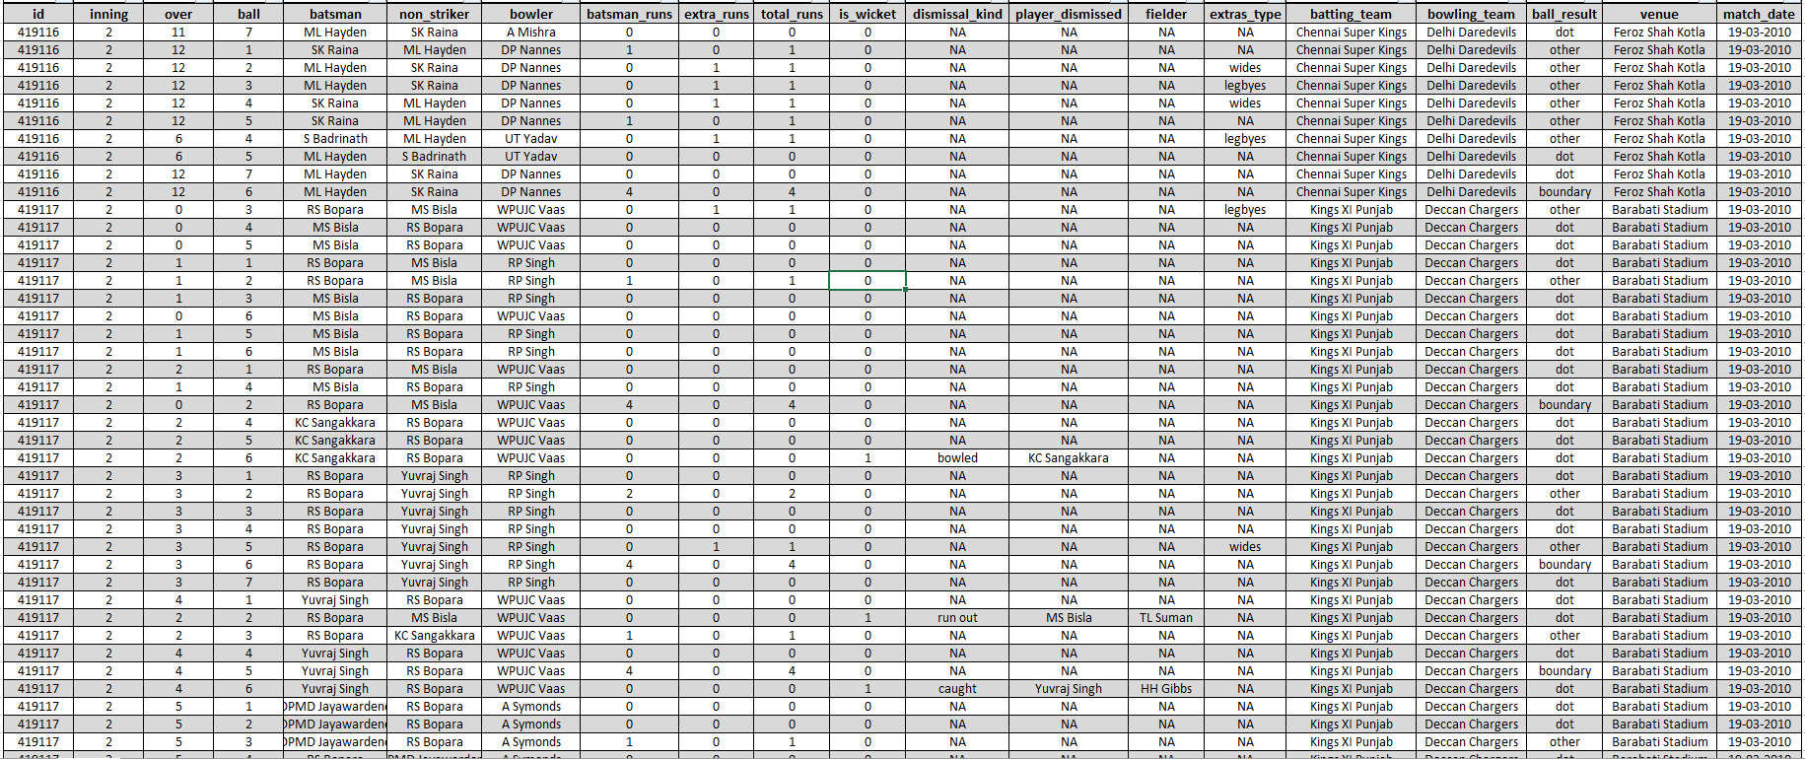
ADDITIONAL QUESTION-8 ( OUTPUT )
ADDITIONAL QUESTION-8
20

Slide 21
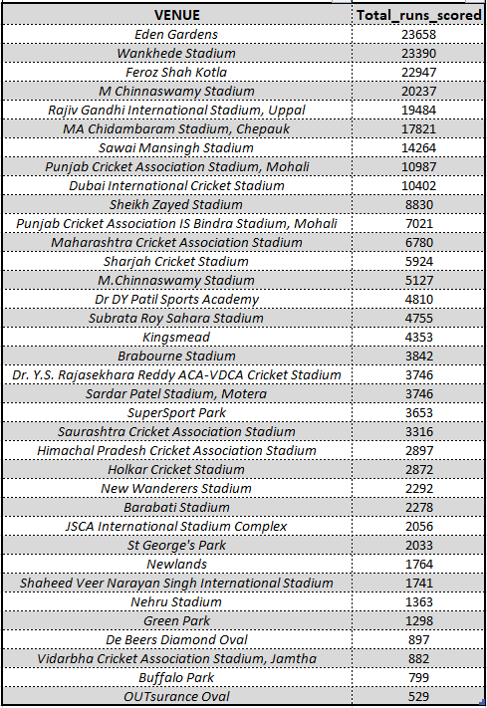
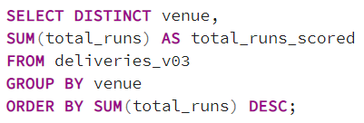
ADDITIONAL QUESTION-9
Write a query to fetch the total runs scored for each venue and order it in the descending order of total runs scored.
REALLYGREATSITE.COM

Slide 22
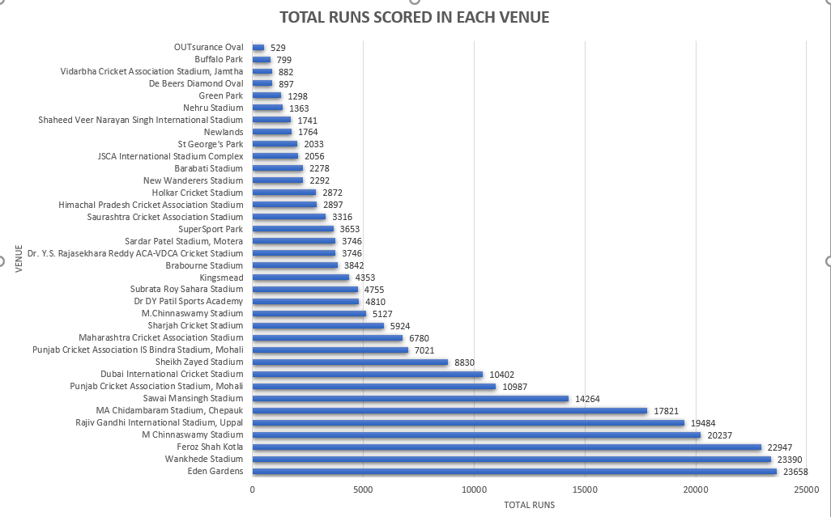
ADDITIONAL QUESTION-9 (OUTPUT)
REALLYGREATSITE.COM
22

Slide 23
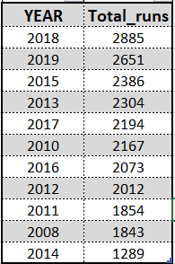
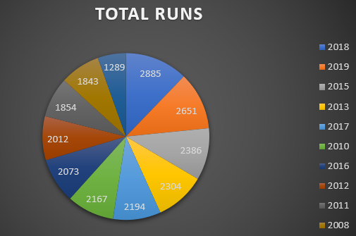
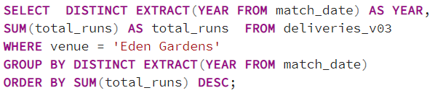
ADDITIONAL QUESTION-10
Write a query to fetch the year-wise total runs scored at Eden Gardens and order it in the descending order of total runs scored.
REALLYGREATSITE.COM

Slide 24

CONCLUSION
In this project, I explored the use of SQL to analyze data. I learned how to query data from a database, how to use aggregate functions, and how to create visualizations.
I also learned how to use SQL to perform data cleaning and data analysis. This project was a great opportunity to learn about the power of SQL and how it can be used to analyze data.
It is a valuable skill for anyone who works with data. In the future, I would like to learn more about SQL and how it can be used to solve more complex problems, I am grateful for the opportunity to have worked on this project, I would like to thank the concerned teachers who put a lot of efforts to teach this skill. I learned a lot and I am excited to use my new skills in the future.

Slide 25




CONTACT
+91 8507053209
adilmuzaffar96@gmail.com
THANK YOU

